Slide 1
Performance Augmentation Using Biosignals
Cooper Wolfden
Supervisor: Kenneth POpe

Slide 2

Introduction
Additional tool for performers to use
Music responding to dancers
Alvin Lucier – “Music For Solo Performer” (1965)^{[1]}

Slide 3
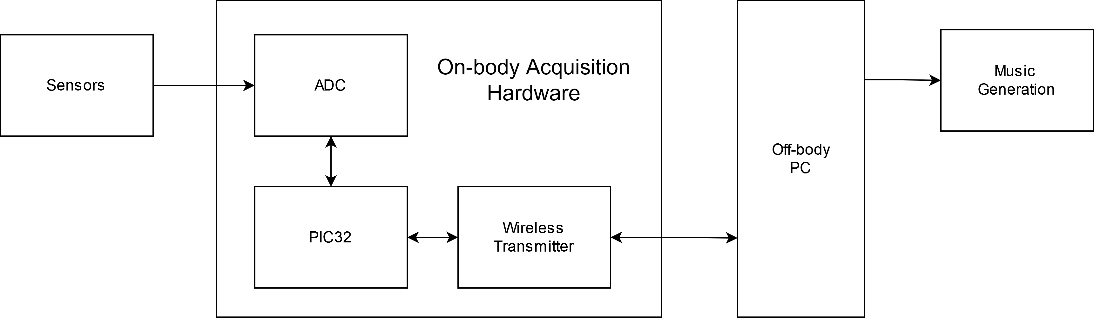
Project Overview

Slide 4
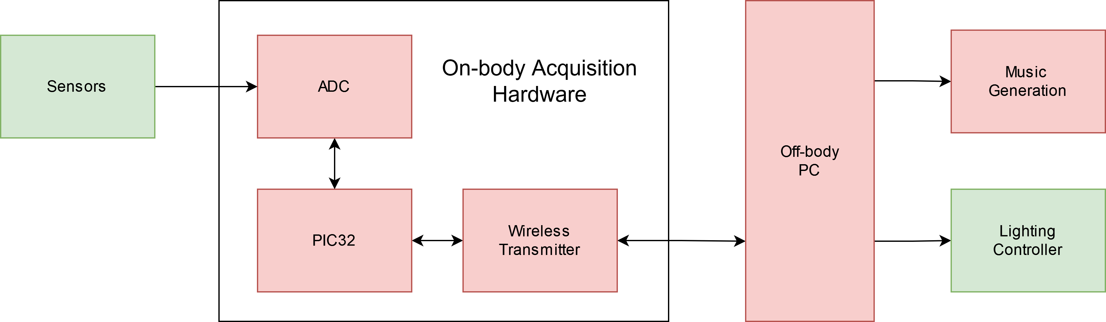
System Addition

Slide 5
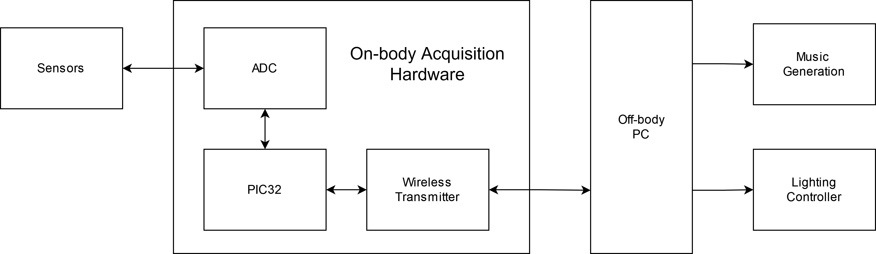
Scope
2nd Semester
1st Semester

Slide 6
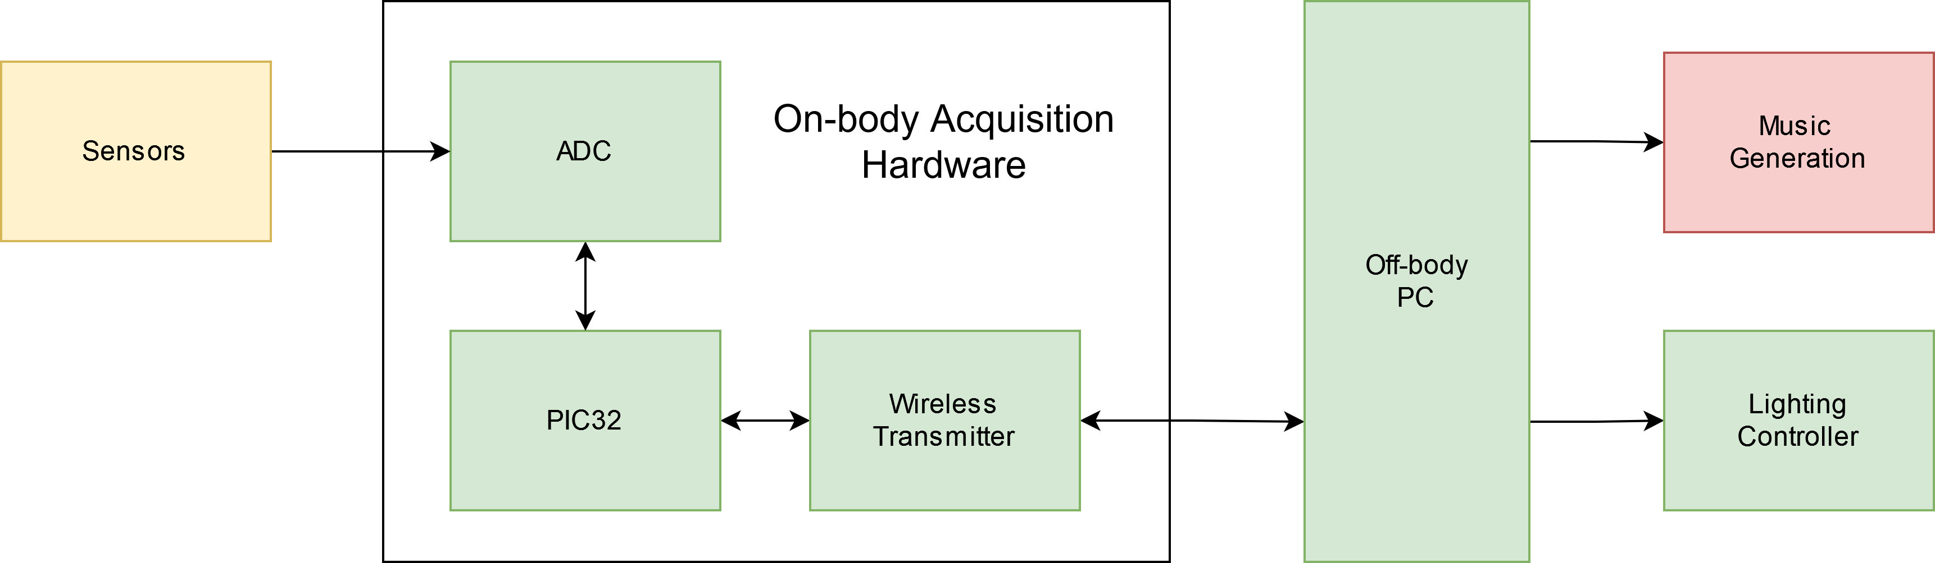
Mid-Year Scope Reassessment
2nd Semester
1st Semester

Slide 7
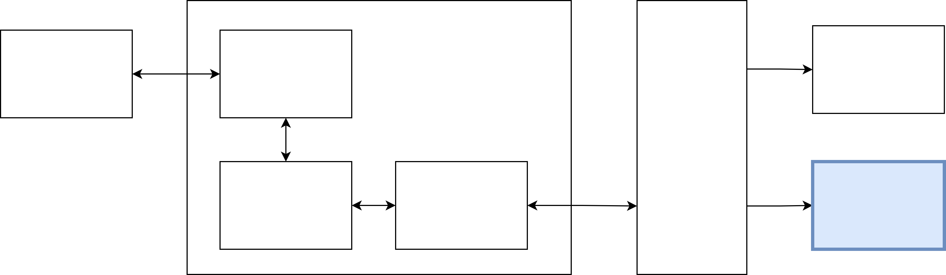
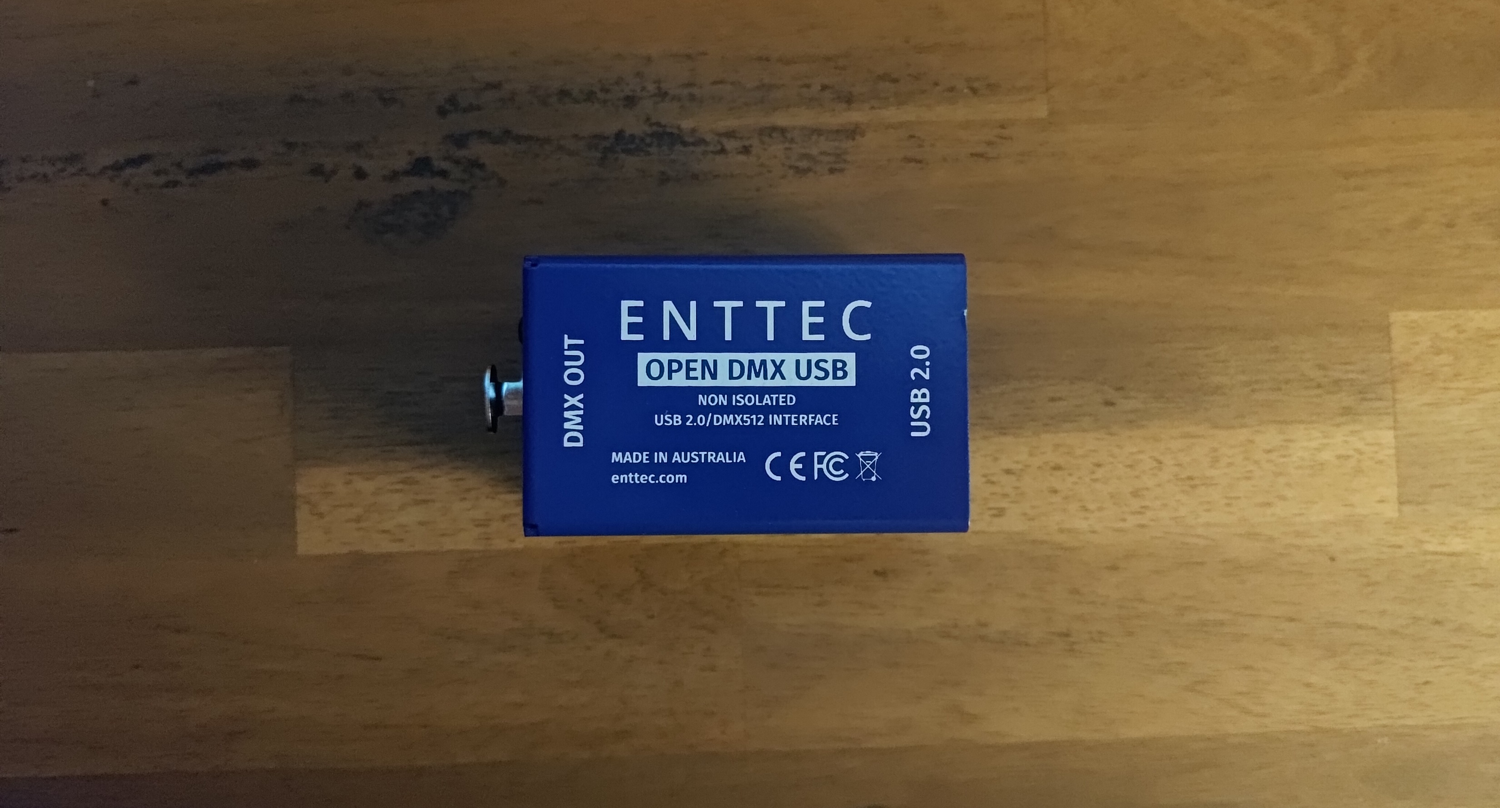
Lighting Controller Overview
Lighting controls the perception of performance space^{[2]}
Enhancement to system

Slide 8
Lighting Controller Decisions
Lighting Protocol | Simplicity | Expense | Scalability | Adoption | Usability | Documentation | Licensing | Total
Weights | 0.70 | 0.80 | 0.60 | 0.90 | 0.90 | 0.70 | 1.00 | 5.60
Normalised | 0.13 | 0.14 | 0.11 | 0.16 | 0.16 | 0.13 | 0.18 | 1.00
BACnet [4] | 0.30 | 0.10 | 0.70 | 0.30 | 0.30 | 0.10 | 0.00 | 0.24
DALI [5] | 0.30 | 0.20 | 0.70 | 0.30 | 0.30 | 0.10 | 0.00 | 0.25
TCP/IP [6] | 0.20 | 0.30 | 0.80 | 0.40 | 0.30 | 0.80 | 0.00 | 0.37
EnOcean [7] | 0.40 | 0.40 | 0.60 | 0.20 | 0.40 | 0.80 | 0.00 | 0.37
0-10V [8] | 0.90 | 1.00 | 0.20 | 0.30 | 0.20 | 0.30 | 1.00 | 0.57
Modbus [9] | 0.80 | 0.70 | 0.90 | 0.50 | 0.40 | 0.90 | 1.00 | 0.73
RDM [10] | 0.40 | 1.00 | 1.00 | 0.80 | 0.70 | 0.90 | 1.00 | 0.83
DMX512 [11] | 0.80 | 1.00 | 0.90 | 0.90 | 1.00 | 0.90 | 1.00 | 0.94
Purchase vs Build | Simplicity | Expense | Documentation | Compliance | Total
Weights | 0.22 | 0.33 | 0.21 | 0.24 | 1.00
Custom controller | 0.10 | 0.40 | 0.30 | 0.20 | 0.27
Off-the-shelf controller | 0.80 | 0.10 | 0.90 | 1.00 | 0.64

Slide 9
Lighting Controller Issues
Open-source driver only available in C#
Required controlling driver from other languages
Previous project code written in MATLAB
Purchasing DMX fixtures out of budget

Slide 10
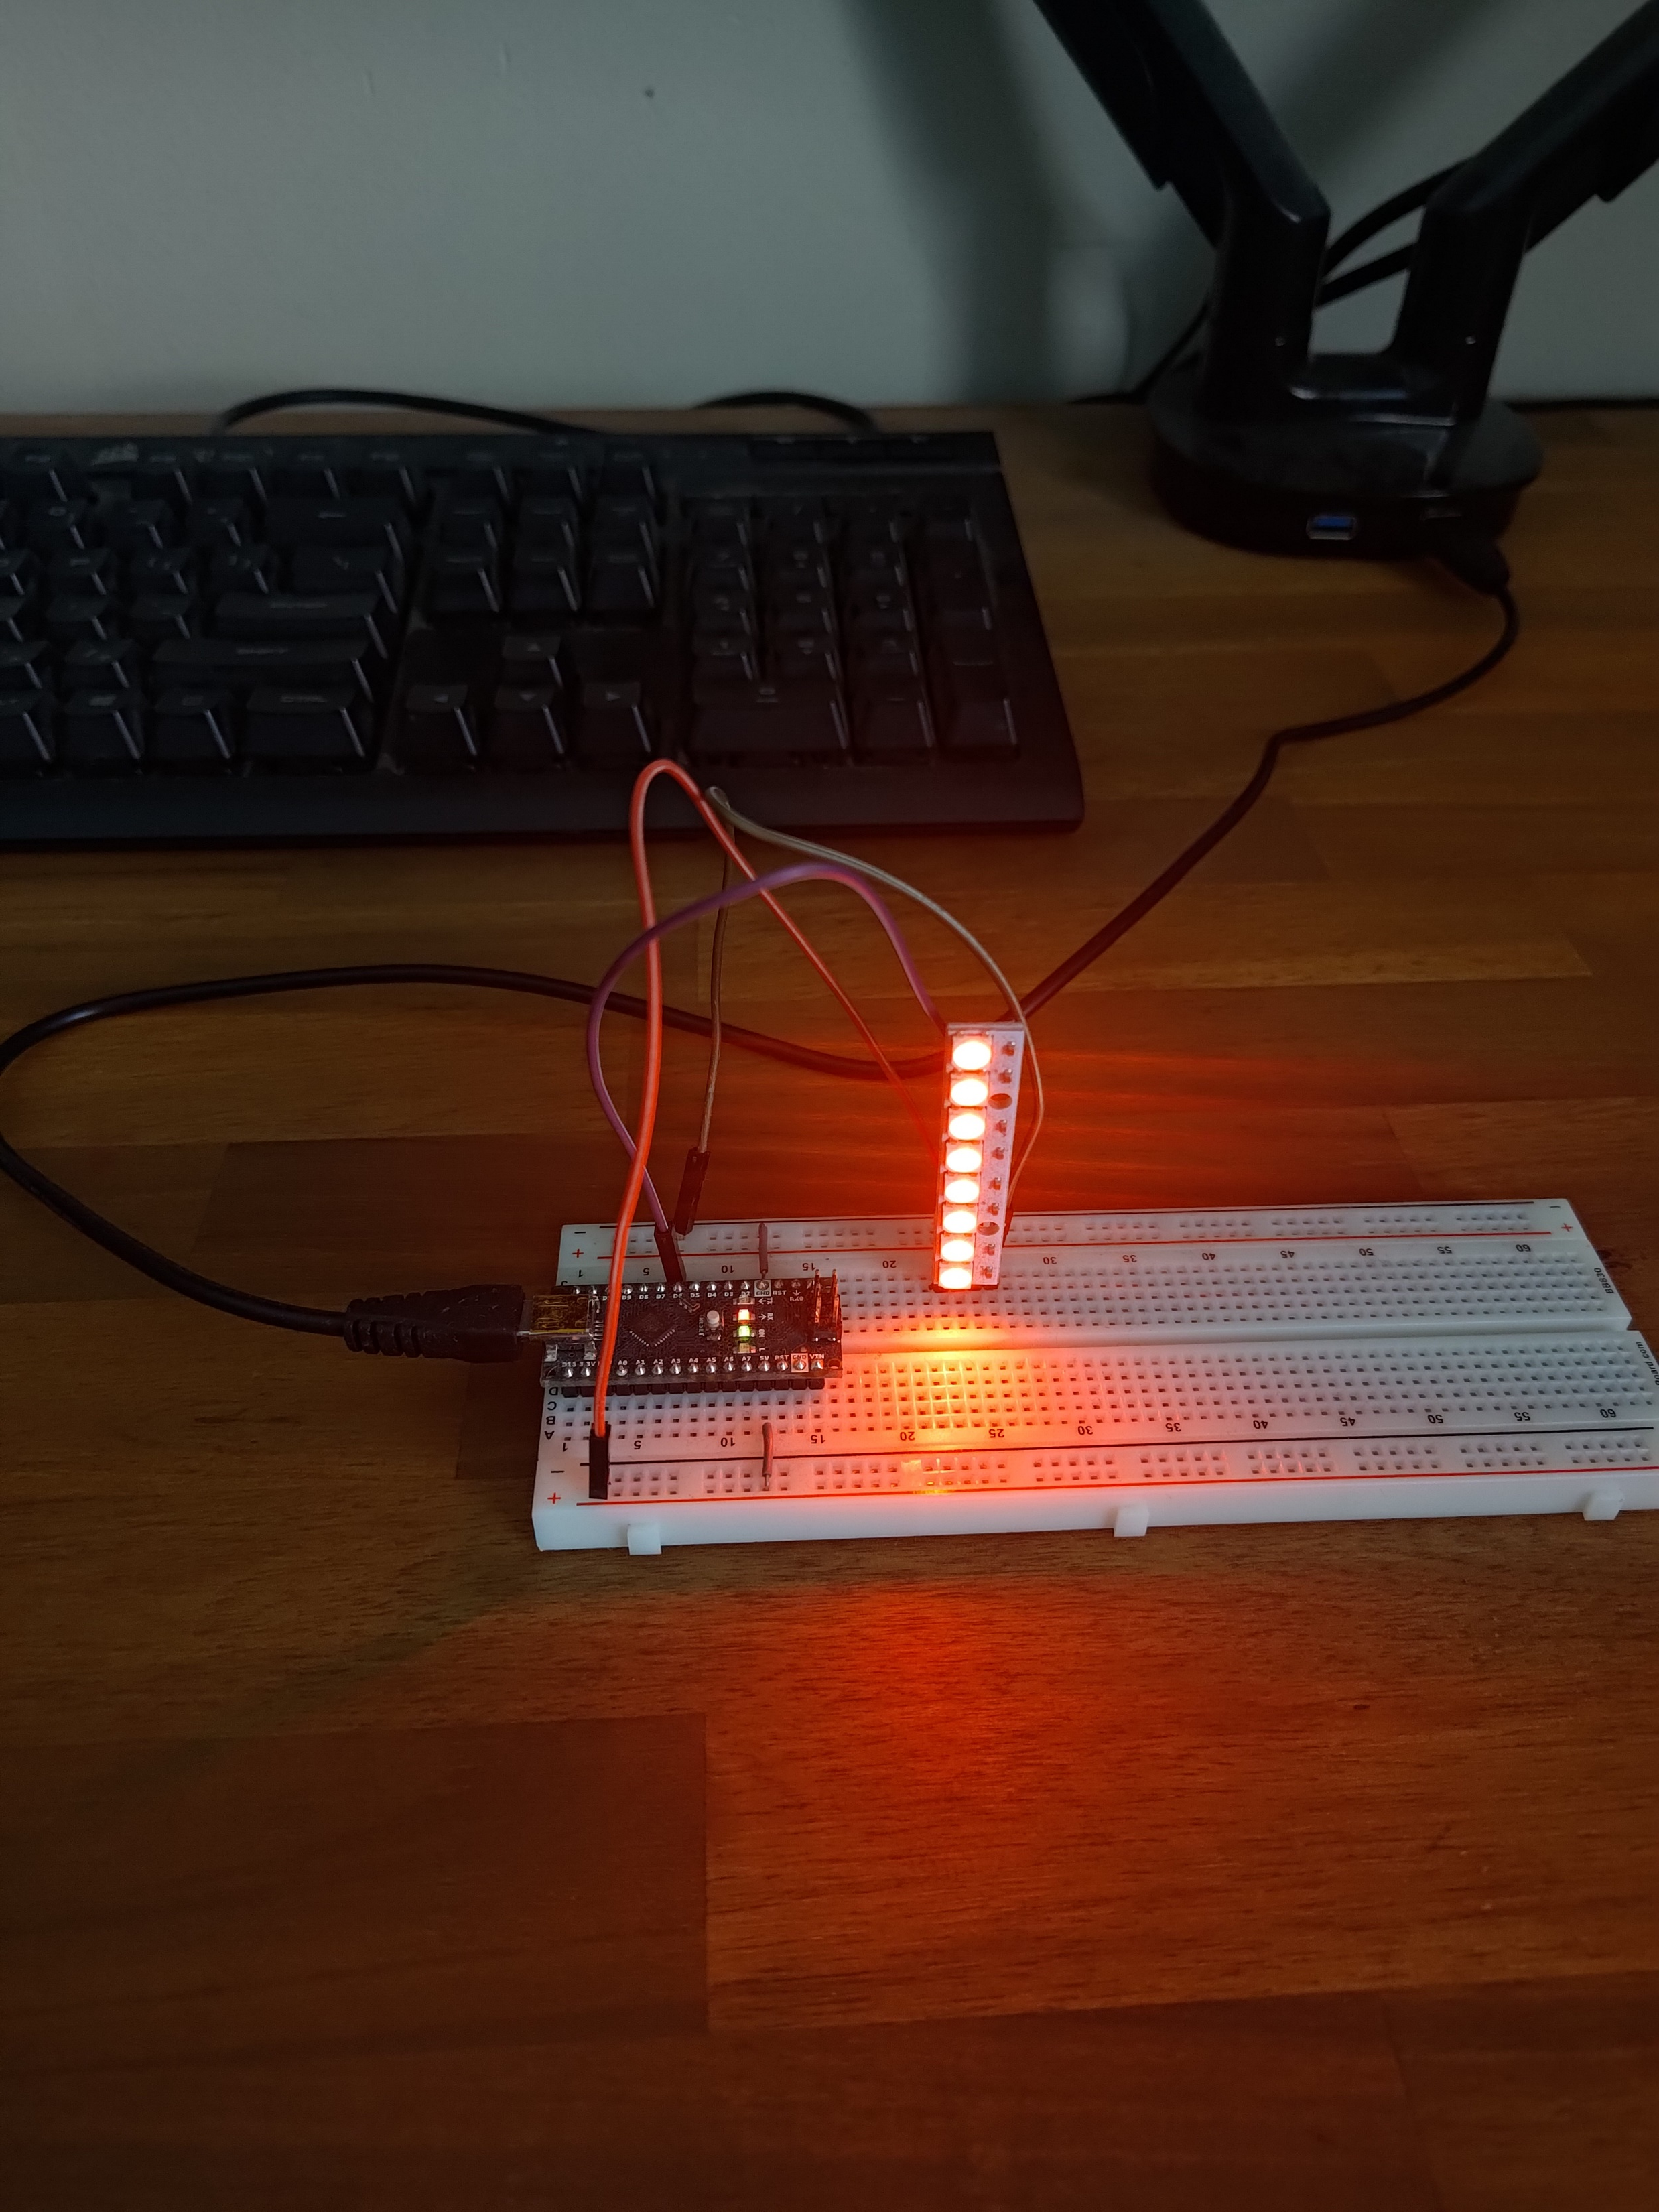
Lighting Controller Results
Testing fixture for prototyping
Both using the same interface
Allows prototyping without costly DMX fixtures
Interface allows full control from MATLAB
TCP/IP Interface
Most high-level programming languages support

Slide 11
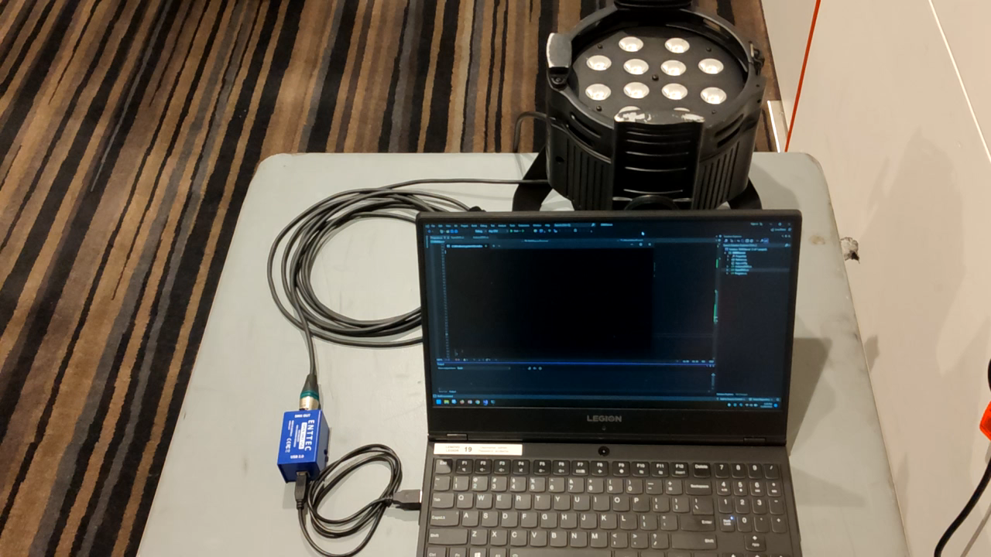
Lighting Controller Results

Slide 12
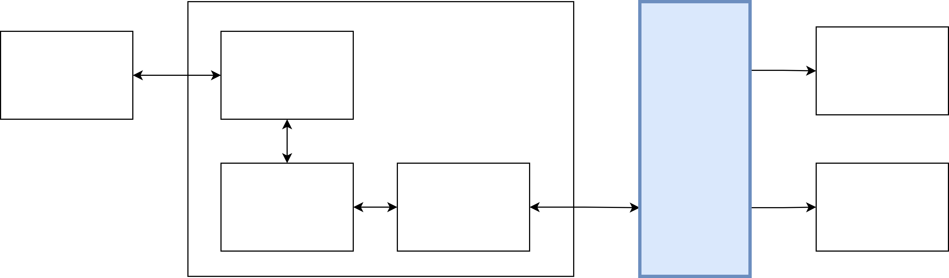
Off-Body PC Overview
Link between on-body device and music/lights
Signal processing of system happens here
Technician interface to system
Transform from signals to artistic output

Slide 13
Off-Body PC Issues
Must be low latency, versatile, resource light
No protocol for sending data
Sensors with different bit resolutions, sampling frequencies, etc
Sensor design is a stretch goal
Don’t want to limit sensors due to protocol
Don’t want to limit sensors with poor protocol choice

Slide 14
Off-Body PC Results
Flexible protocol
Terminators instead of fixed data length
Limits data character set
33% overhead
Future work could reduce to 25%
Header Identifier | Data Type
Data Byte 1 | Data Byte 2 | Data Byte 3 | Data Byte 4
Data Byte n-2 | Data Byte n-1 | Data Byte n | Terminator

Slide 15
Off-Body PC Results
Process data streams in MATLAB
Callback function to receive data
Variably sized FIFO^{[3]} buffers for different signals
Identical processing of real signal and test signal
Round trip time of 30ms for 32 bytes

Slide 16
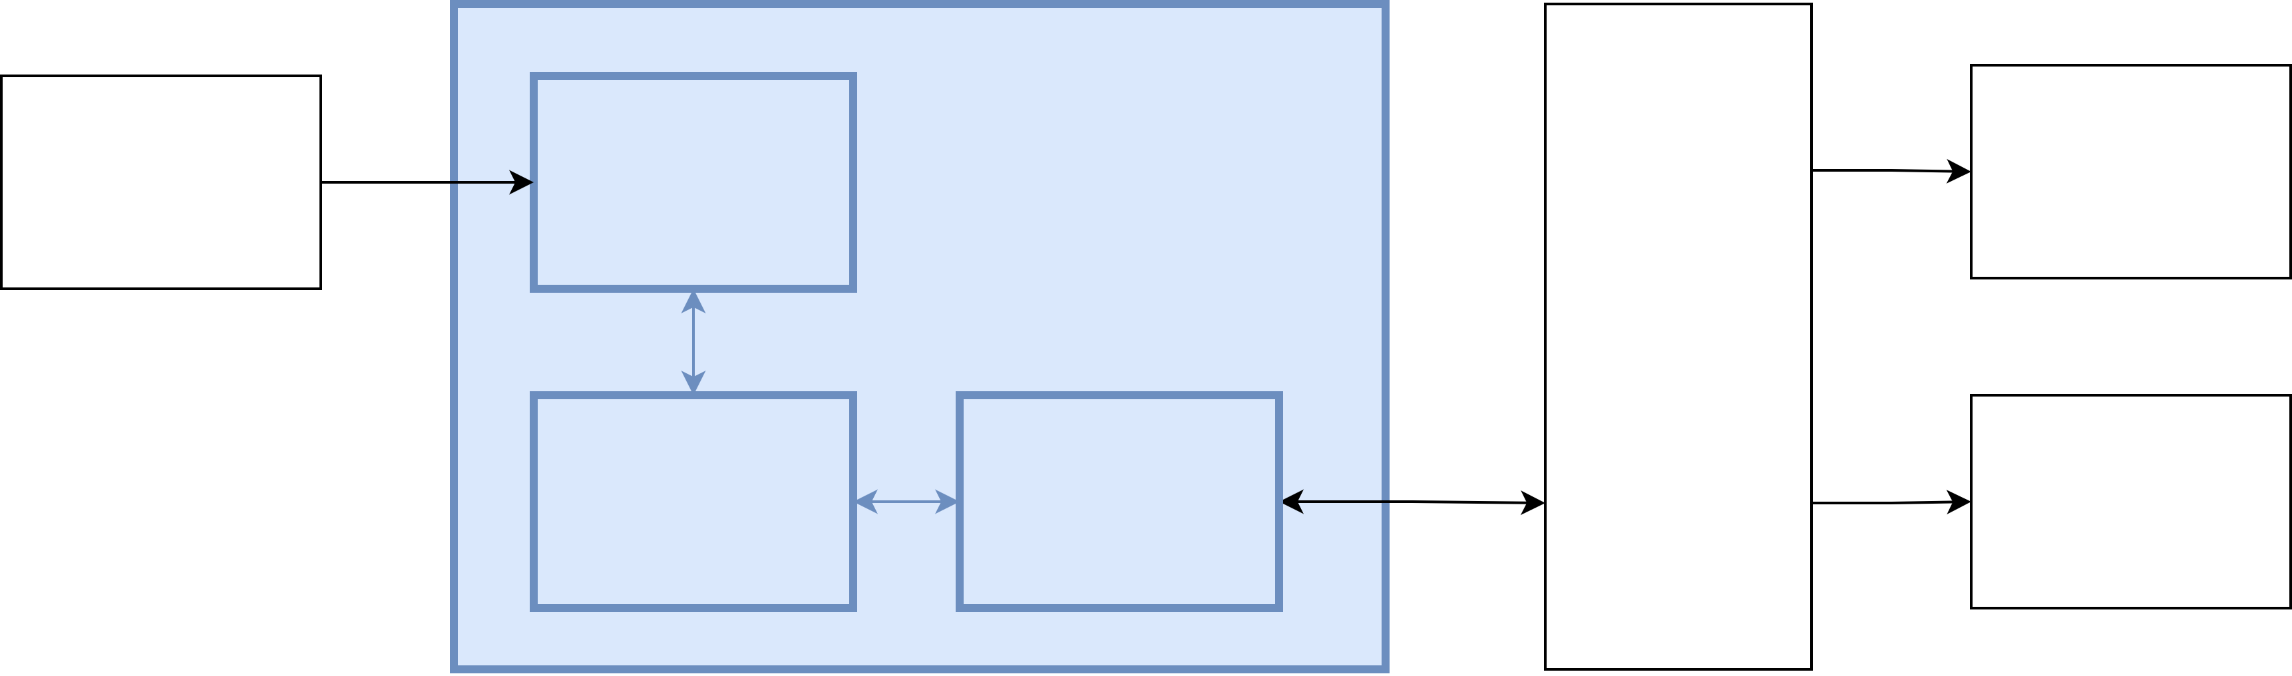
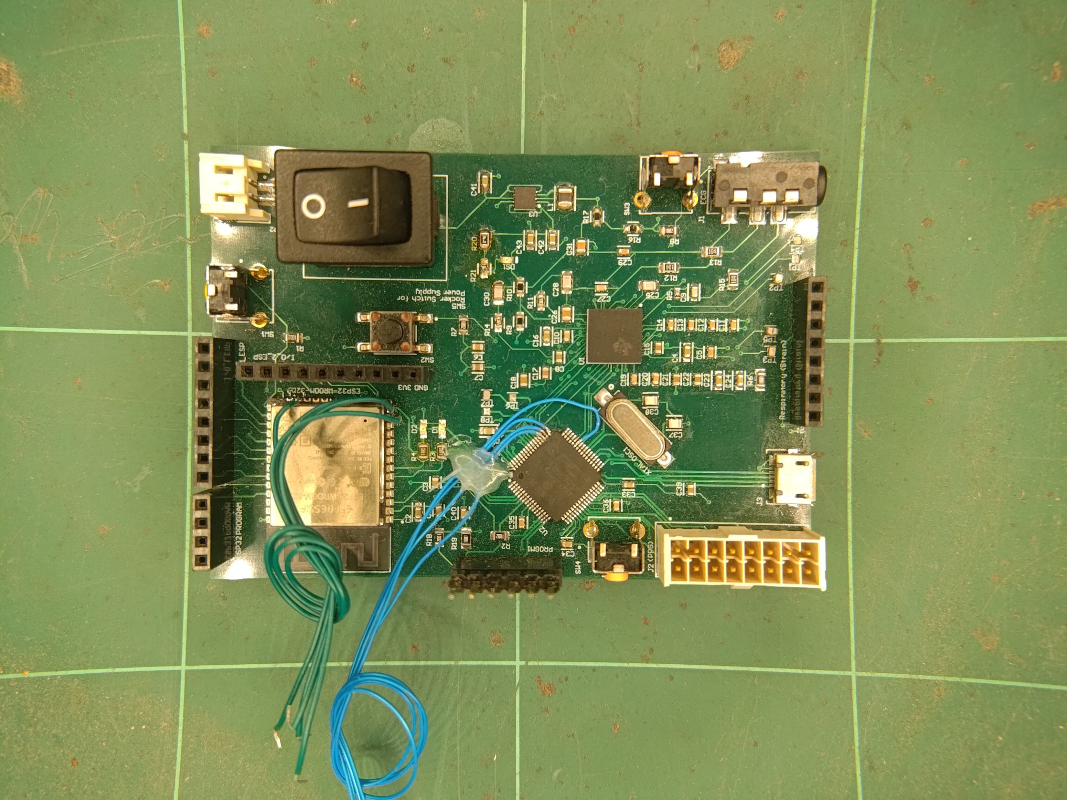
On-Body Device

Slide 17
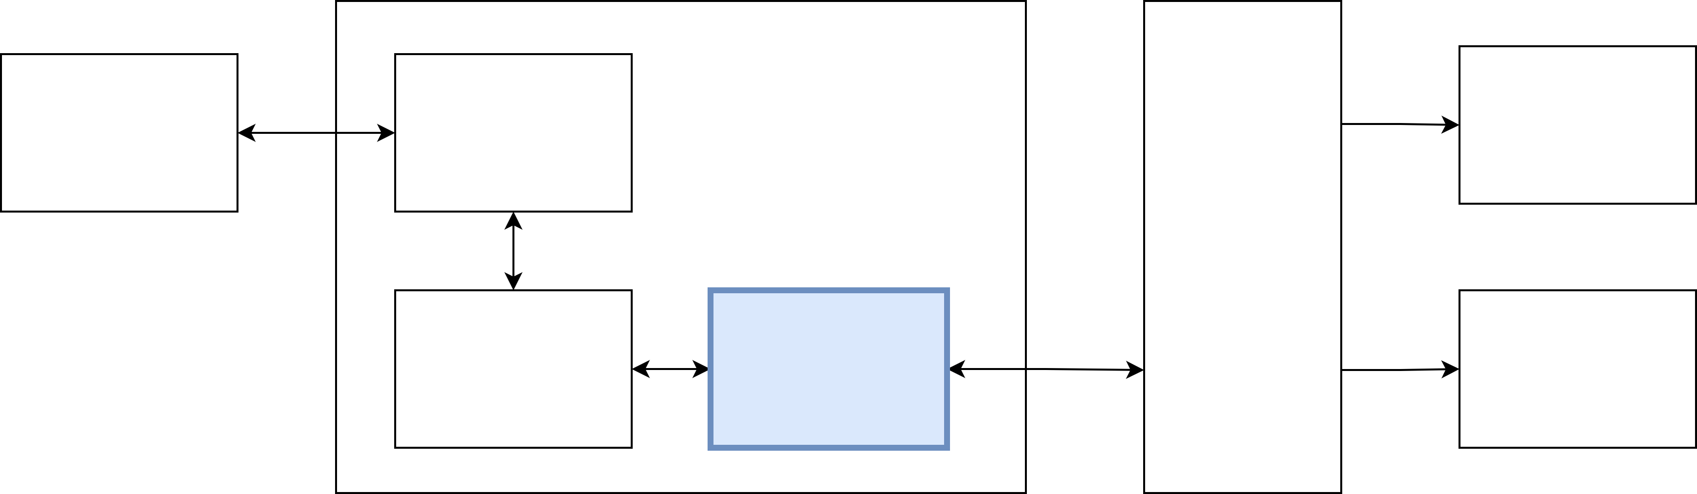
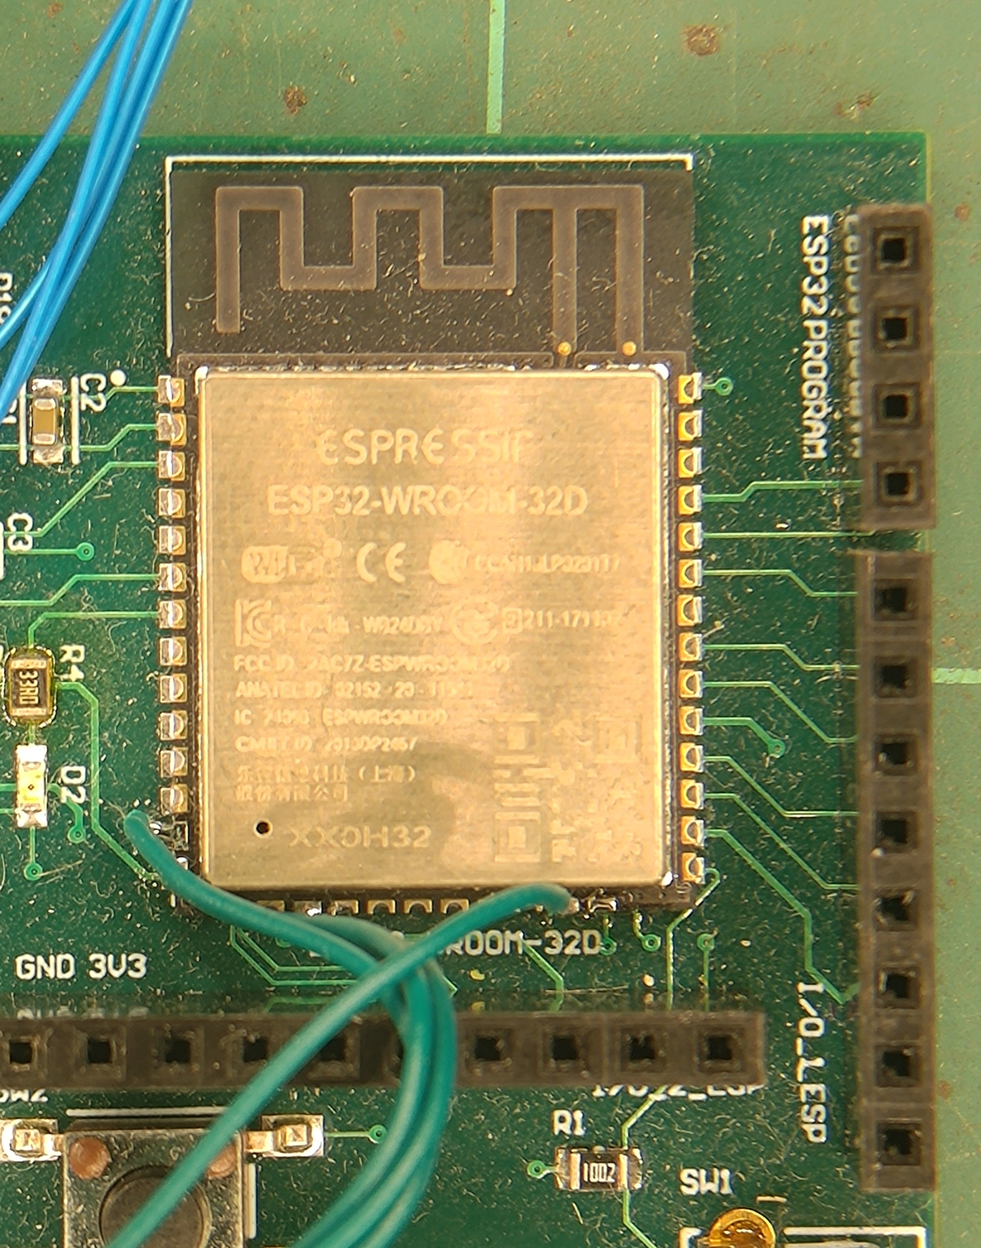
ESP32 Overview
Communication bridge between on-body device and off-body PC

Slide 18
ESP32 Issues
Board only programs intermittently
Must be placed in correct boot mode
No easy way to check if correctly set
Reset without warning due to brownout detection reset
Failure to program >50% of time
Compilation is slow, failure wastes time
Compilation takes around 40 seconds (PIC takes 2 seconds)
Miniscule recompilation optimisation
Need to recompile even when nothing has changed
Do not want to program often

Slide 19
ESP32 Results
Implemented Over-The-Air updates
Does not need to put into specific boot mode
Allows wireless programming
Successfully programs >95% of the time
Originally contained protocol definition
Easier to prove device was functional
Required protocol to be fixed
Protocol defined in several places
Over several iterations device became generic
Allows device to be unaware of changes to protocol
No reprogramming required

Slide 20
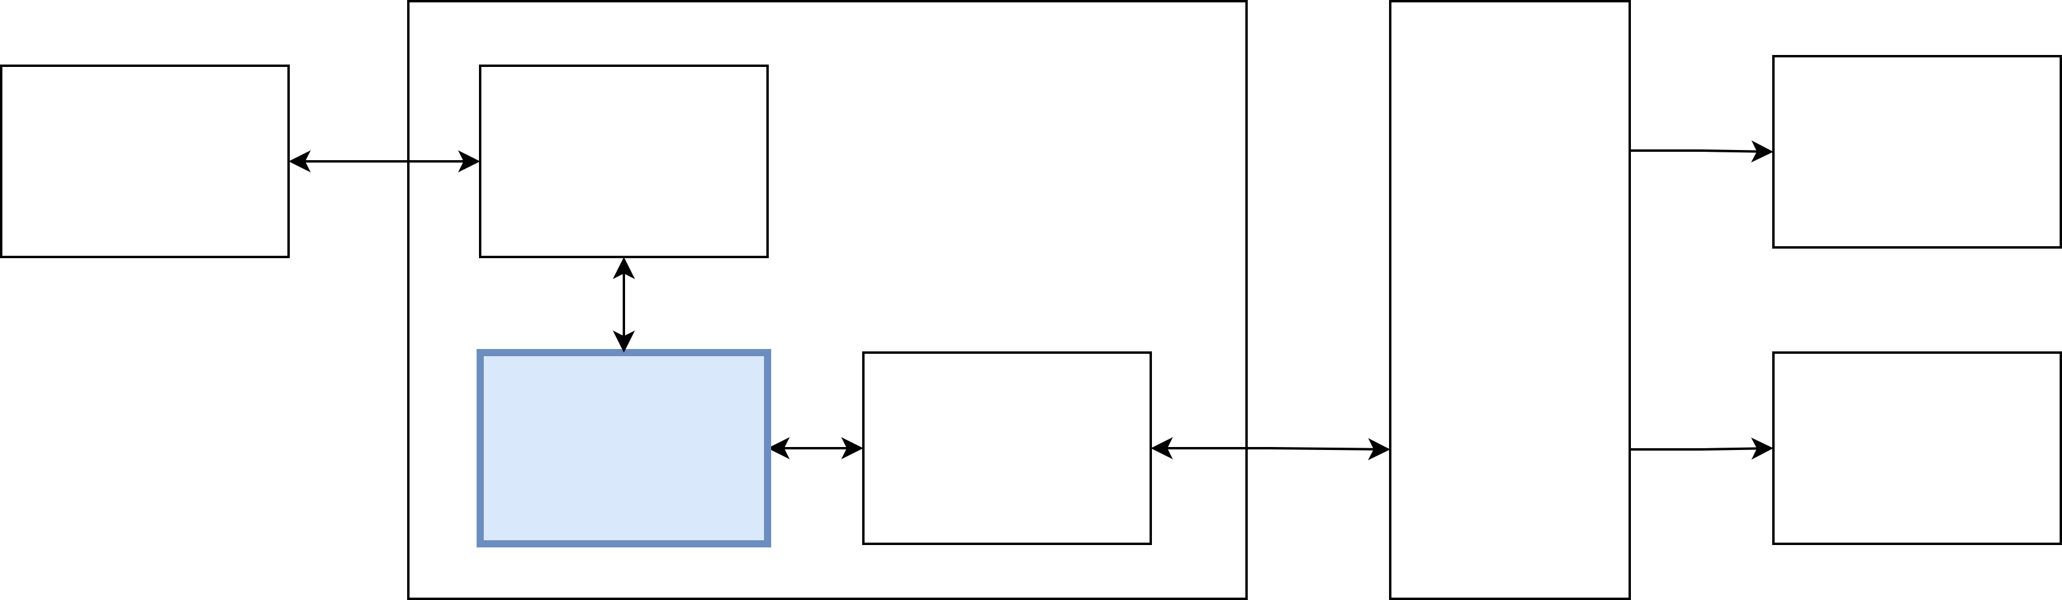
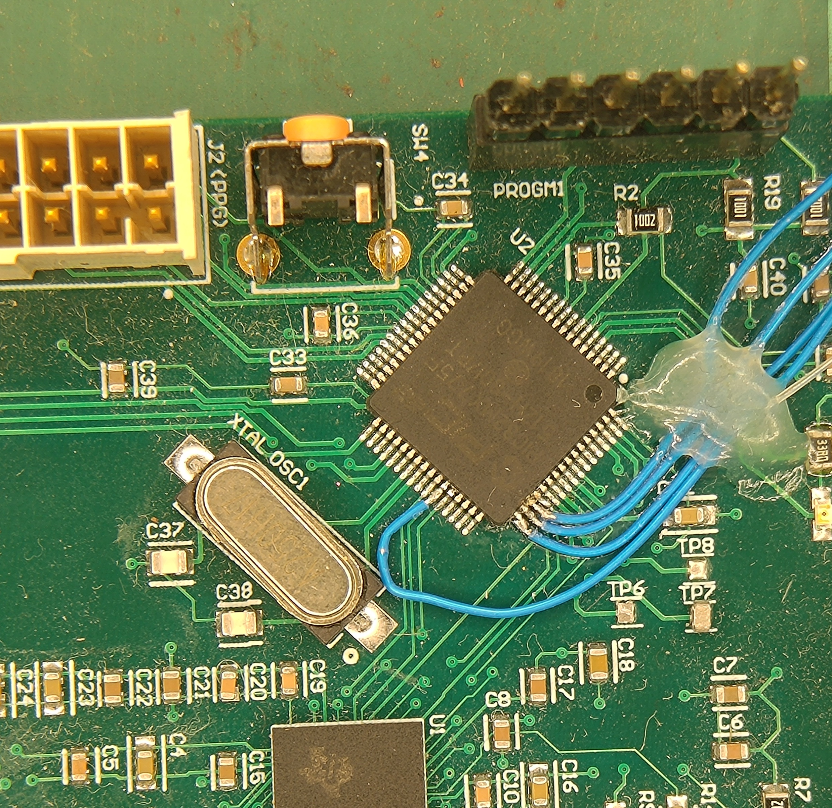
PIC32 Overview
“Brain” of on-body device
Communicates with all on-body devices and sensors
Most visited place for engineering changes

Slide 21
PIC32 Issues
Clock configuration must be done manually
Unable to debug if not correct
Microcontroller is programmed in C
Lack of community support (not an Arduino)
No library support for hardware
Limited memory environment
Heap not allocated
Variable sized data difficult to work with
Non-prototype friendly design
No LEDs
Few test points (none on communication lines)

Slide 22
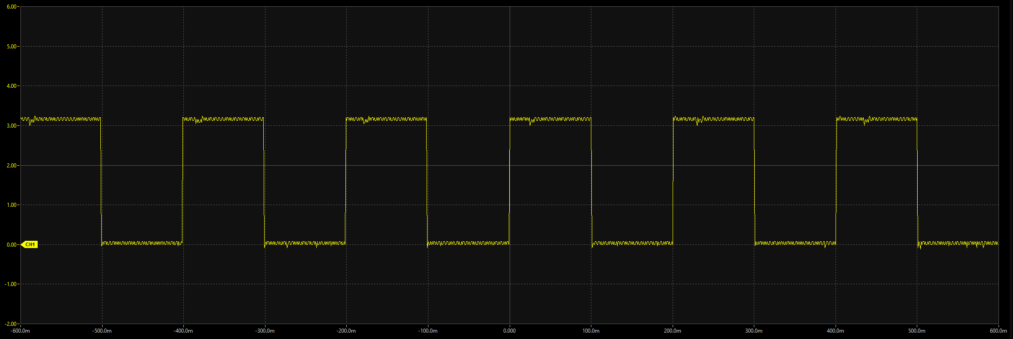
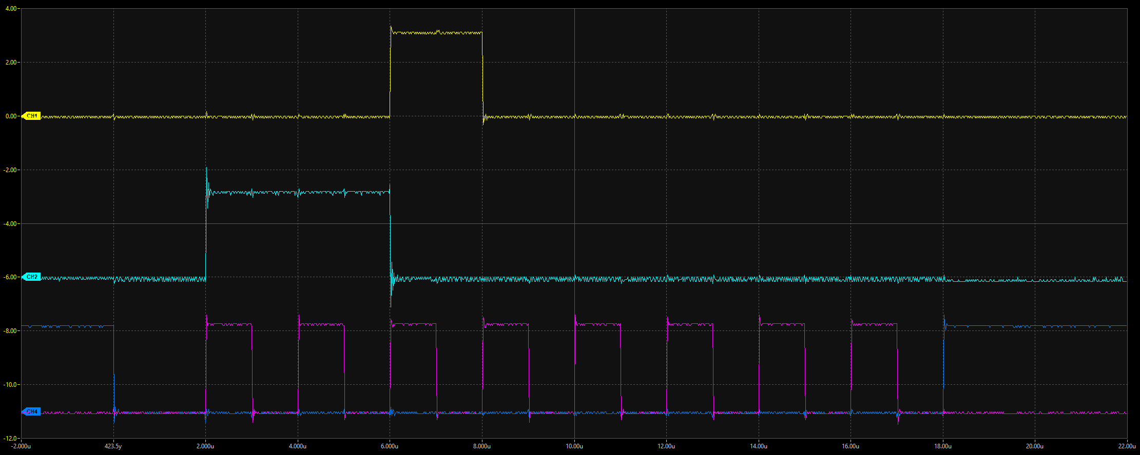
PIC32 Results
Clock speed can be set up to 80MHz
Slower speeds also available for power saving
Timing verified using oscilloscope
Custom drivers for all peripheral hardware
Only hardware related dependencies

Slide 23
PIC32 Results
Variable data packets
Data packet defined as structs
Fixed length encoding based on size of structs
Packets can be changed while maintaining fixed length at runtime
Wifi debugging using printf
Implemented custom debug function
Since protocol is flexible, just added header
No additional requirements

Slide 24
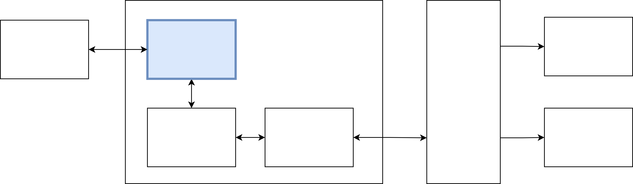
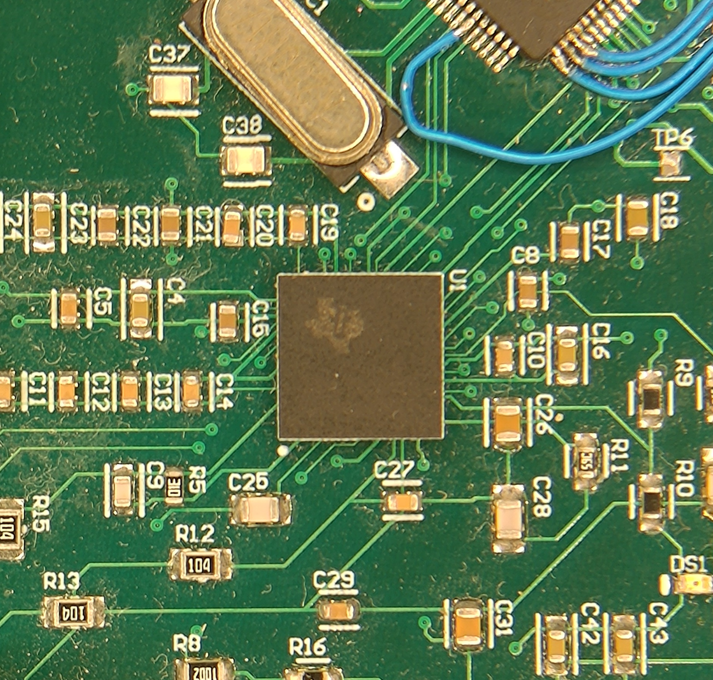
ADC Overview
Chip designed specifically for heart monitoring
24-bit resolution, 4-channel ADC
SPI communication with PIC32

Slide 25
ADC Issues
No test points on communication lines
Device responds to some commands but not others
Non-typical SPI communication
Many potential timing/configuration issues
Hard to determine what specific combination
Missing physical control lines
No way to hardware reset device via PIC32

Slide 26
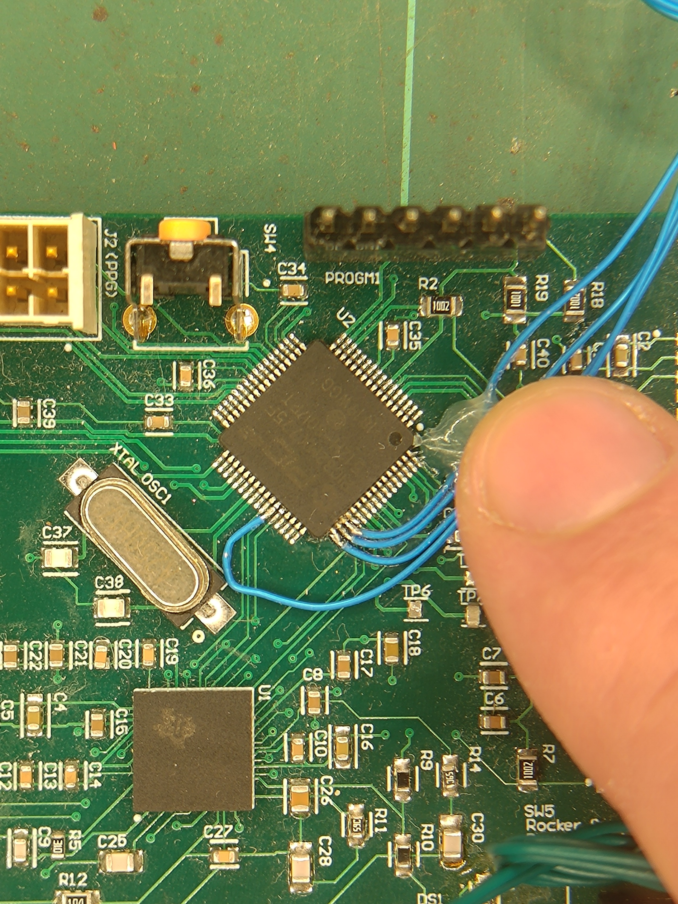
ADC Results
Hand soldered wires to device pins for probing
Thankyou Craig Dawson
Slowed down communication
Well below data sheet maximums
Added adequate delays between commands
Chip select line causes data reset
Needs to be asserted for entire duration
Must be done manually, not a configuration in SPI module

Slide 27
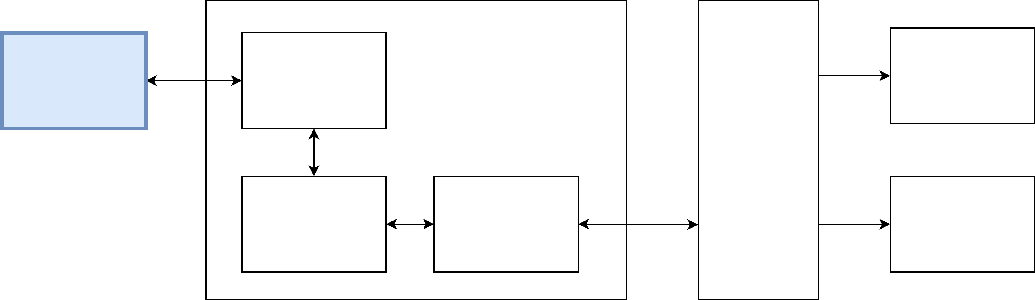
Sensors Overview
Ergonomic human interface design
Stretch goal of project
Electrodes for muscle and heart readings
4 channels of ADC
Microphones for mechanical muscle sensing
12 channels of PIC32 analog inputs
Amplification/filter requirements
Breathing strap
Additional input on ADC

Slide 28
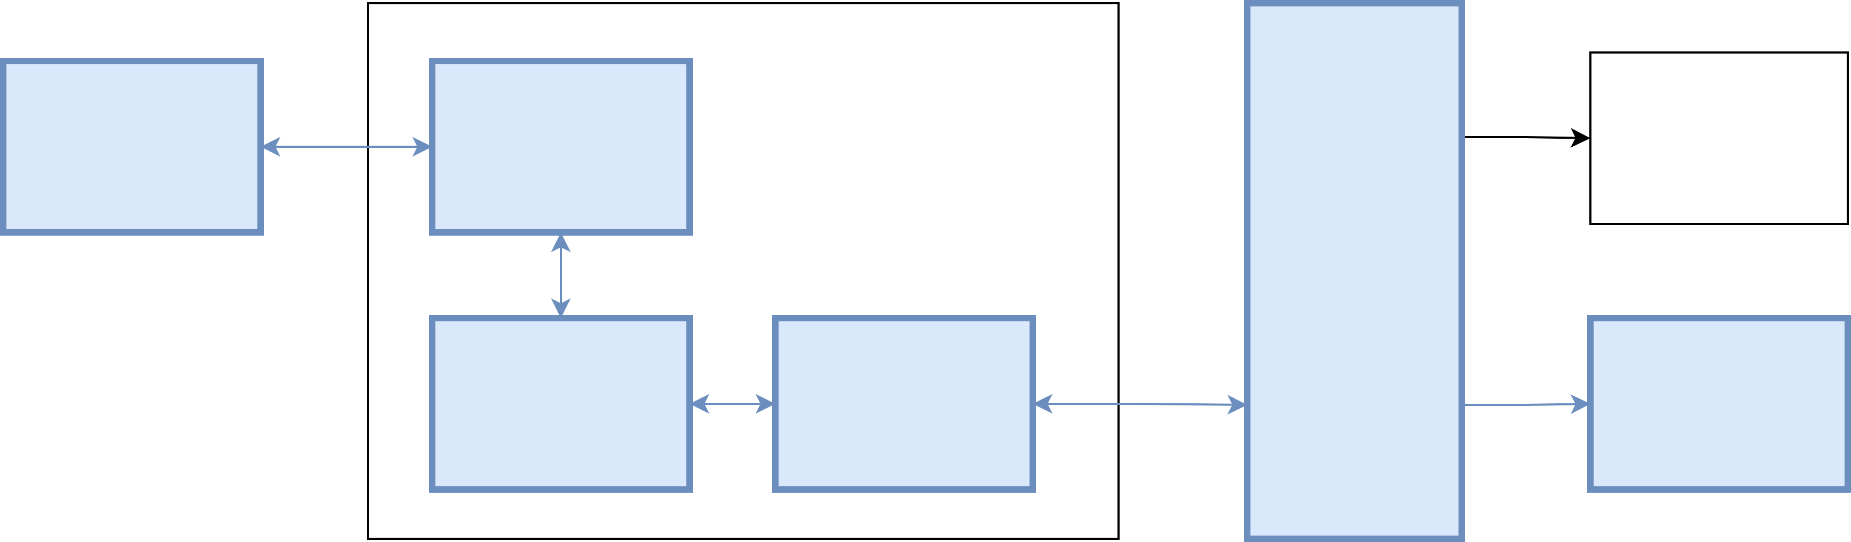
System Integration Issues
Board power distribution causes voltage drops
Components work in isolation, fail when powered together
Difficult to test and quantify
Testing setup requires connection to off-body PC
Off-body PC connection requires ESP32, etc

Slide 29

System Integration Results
Successful communication between off-body PC and lighting controller
Successful communication between ESP32 and off-body PC
Successful communication between PIC32 and ESP32
Successful communication between ADC and PIC32
Successful communication between PIC32 and off-body PC
Mean bit rate of 1.45 kbits/s over 20 kbits^{[4]}
Bit error rate of 0 over 1 Mbit^{[5]} (run at max rate for 30 minutes)

Slide 30

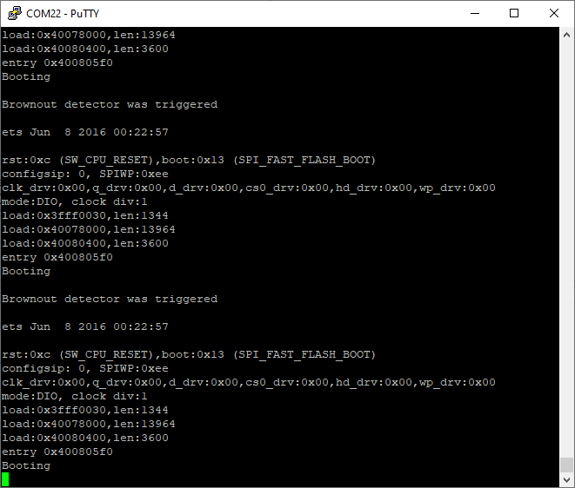
System Integration Results
Full system bring up causes power supply failures
System powered from lab bench power supply
Current limit well above what system is using
Measuring 2.6V where should be 3.3V input

Slide 31
Conclusion

Slide 32
Conclusion

Slide 33
Completion Plan
Board power supply issues
Determine cause
Implement possible solutions
Disconnecting power hungry consumer (internal short?)
Inject power at specific points (high power plane impedance?)
Disconnect probe wires (short between adjacent pins?)
Update recommendations for on-body board revision
Sensor integration
Simple electrodes
Full system data flow
Receive sensor data in MATLAB

Slide 34
Future Work
Second version of on-body device
Prototyping friendly design (LEDs, test points, etc)
Simplified wireless communication
Power distribution
Sensor development
Ergonomic wearable sensor design
Link speed
Reduction of delays in communication
Consideration of custom ESP32 SPI library
Artistic programming and performance
Simplified user interface
Live performance

Slide 35
References
[1] | C. Conceição, "Alvin Lucier - "Music For Solo Performer" (1965)," 28 November 2010. [Online]. Available: https://www.youtube.com/watch?v=bIPU2ynqy2Y. [Accessed 18 September 2023].
[2] | Y. Abulafia, The Art of Light on Stage: Lighting in Contemporary Theatre, Routledge, 2015.
[3] | C. Cummings, "Simulation and Synthesis Techniques for Asynchronous FIFO Design with Asynchronous Pointer Comparisons," SNUG, San Jose, 2002.
[4] | P. C. Gupta, Data Communications and Computer Networks, PHI Learning Pvt. Ltd., 2006.
[5] | M. Jeruchim, "Techniques for Estimating the Bit Error Rate in the Simulation of Digital Communication Systems," IEEE Journal on Selected Areas in Communications, vol. 2, no. 1, pp. 153-170, 1984.

